Slide 1


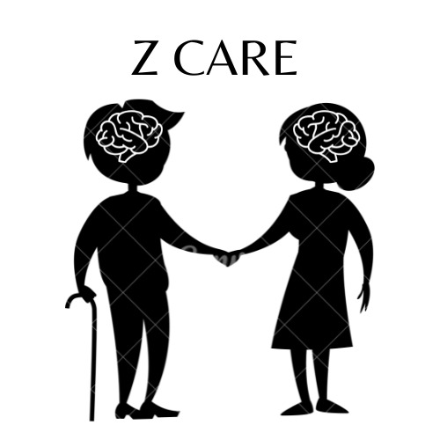
Z Care
Supervised by:
Dr. Esraa Elhariri
Dr. Asmaa Hashem

Slide 2
TABLE OF CONTENTS
03.
01.
02.
Introduction
Problem Definition
Objective and Motivation
04.
Literature review
05.
06.
Proposed System
Discussion & Experimental Results
07.
08.
Conclusions & Future Work
Our team

Slide 3
Alzheimer
A slowly progressing, but devastating disease.

Slide 4
01.
Introduction

Slide 5
INTRODUCTION
Dementia is most common in people over the age of 65.
The risk of Alzheimer's disease and other types of dementia increases with age, affecting an estimated 1 in 14 people over the age of 65 and 1 in every 6 people over the age of 80.
.

Slide 6
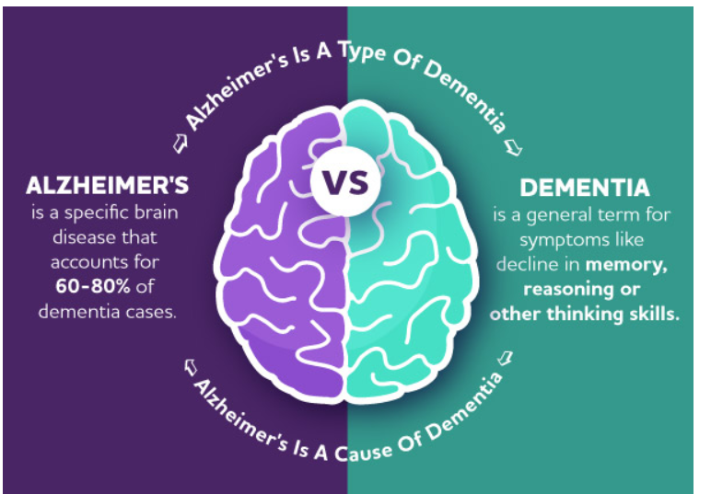
INTRODUCTION
Dementia is the name for a group of symptoms associated with an ongoing decline of brain functioning. It can affect memory, thinking skills, and other mental abilities.

Slide 7
55 million
10 million

Slide 8
02.Problem Definition

Slide 9

Problem Definition
Age
Z care
lifestyle factors and conditions associated with cardiovascular disease
a family history of the condition
People with Down's syndrome are at a higher risk of developing Alzheimer's disease.
.

Slide 10
Project objective
03.

Slide 11
Project objective
Developing an automated helpful system.
Diagnose Alzheimer’s disease in its early stages Accurately using:
Deep learning would give us the ability to
Slow the disease progression with medicine and exercises.
Maintain mental function
Make it easier for caregivers to take care of the patient

Slide 12
04.
Literature review

Slide 13
Accuracy 66.7%
Using MRI, FDG-PET, CSF, & genetic features, with Hybrid (CNN & RNN).
Weiming Lin.2021
Shangran Qiu.2022
Zhou, P. et al. 2020
Using MRI with CNN.
PET and MRI images and distinguish between severity using CNN and SVM
Accuracy 69.2%
Accuracy of 87%

Slide 14
Accuracy of 91 %
Accuracy of 91 %
MRI, PET & CSF data with Using SAE,DBM & SVM
using MRI data with Using autoencoder Accuracy of 91 %
fnagi.2019
Ju et al.2017
Shen et al.2019
distinguish AD From mild cognitive impairment using PET data Using Deep Belief Network
Accuracy of 86%

Slide 15
05.
Proposed System

Slide 16


Slide 17
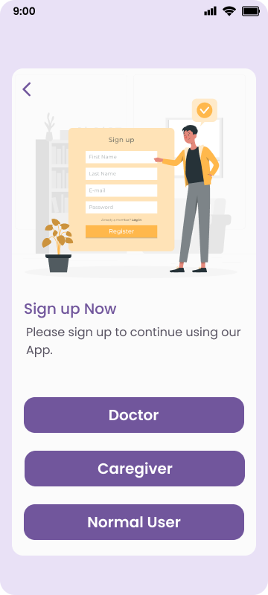



Sign Up Functions

Slide 18
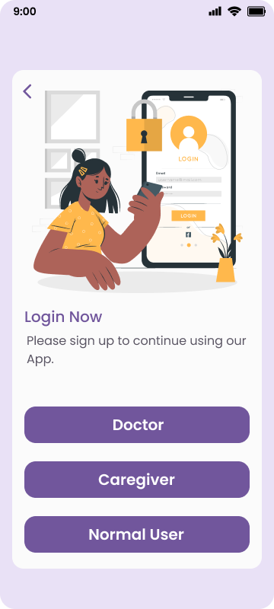


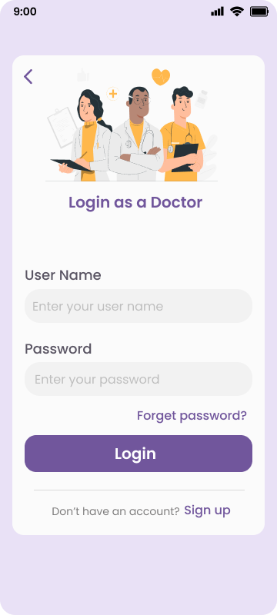
Login Functions

Slide 19


Passwords Functions

Slide 20
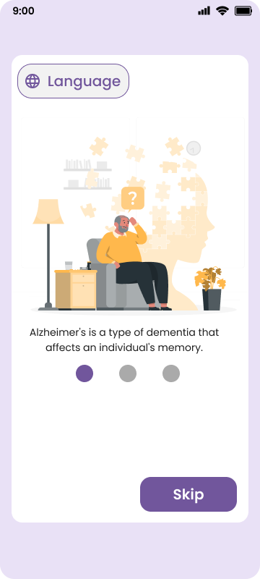
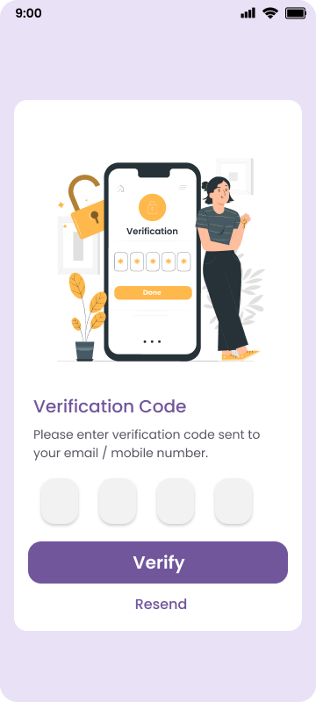
Languages & Verification code

Slide 21


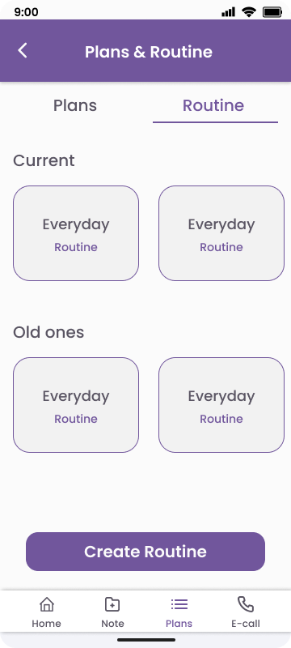


Normal User Features

Slide 22
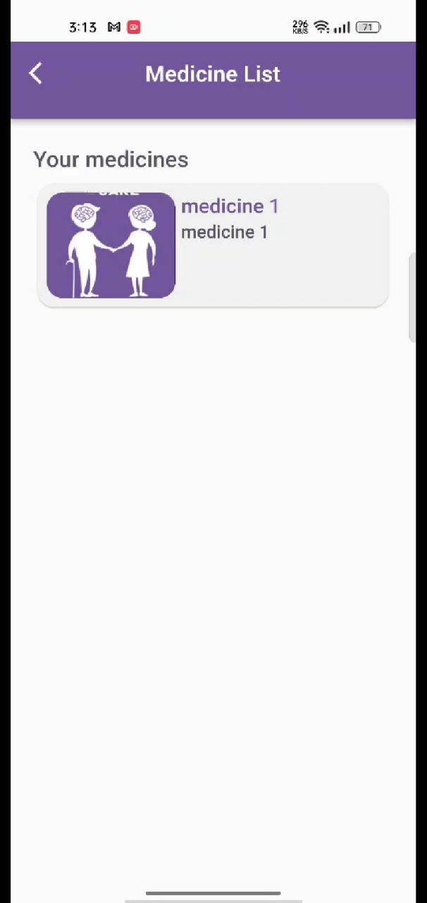
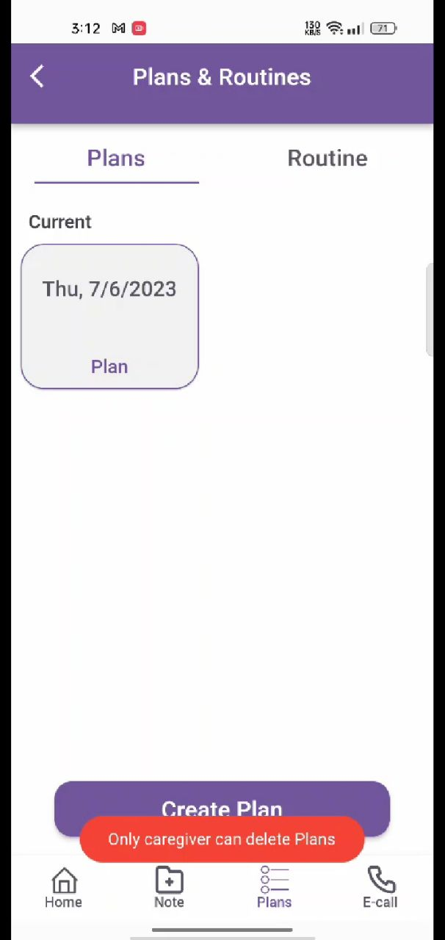
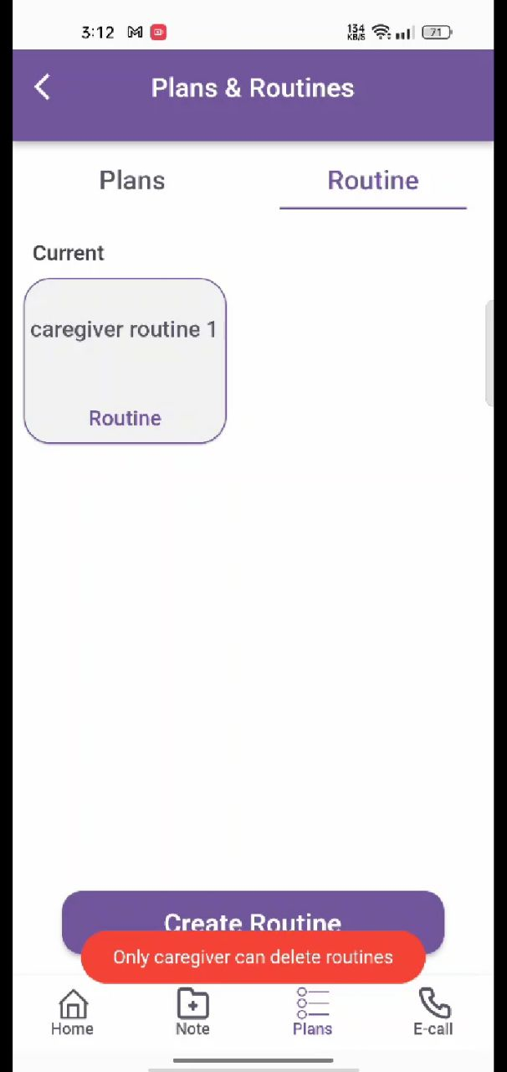
Patient Features

Slide 23


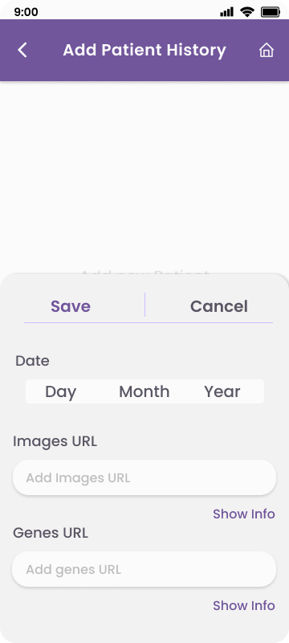
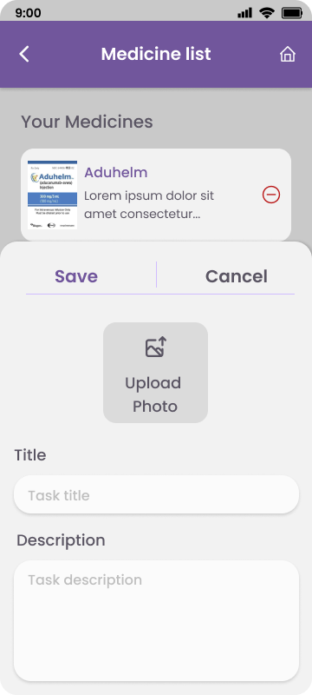
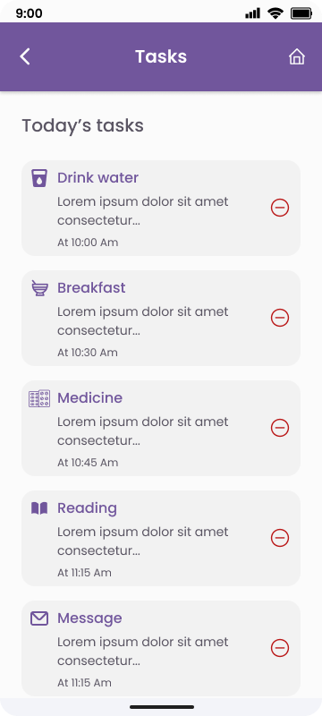
Care Giver Features

Slide 24
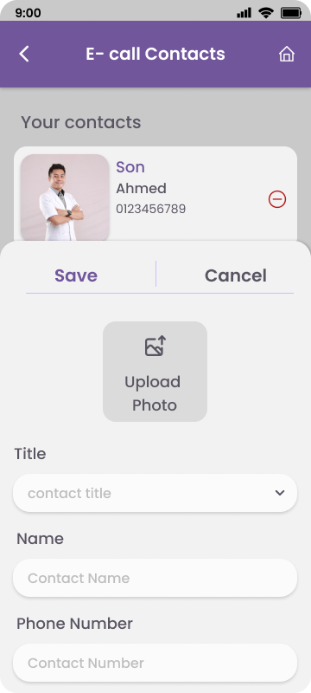

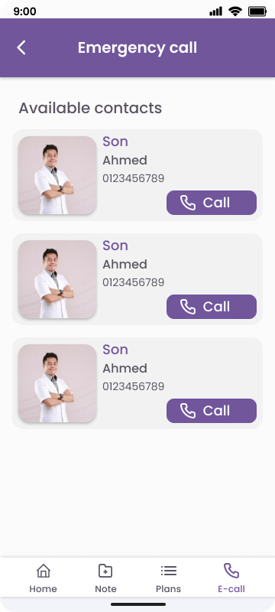
Emergency Functions

Slide 25
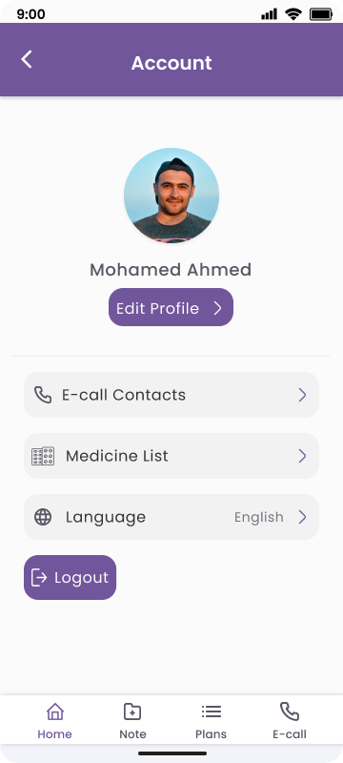
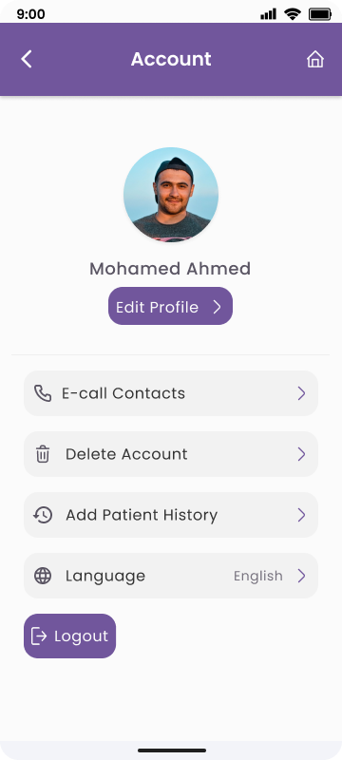
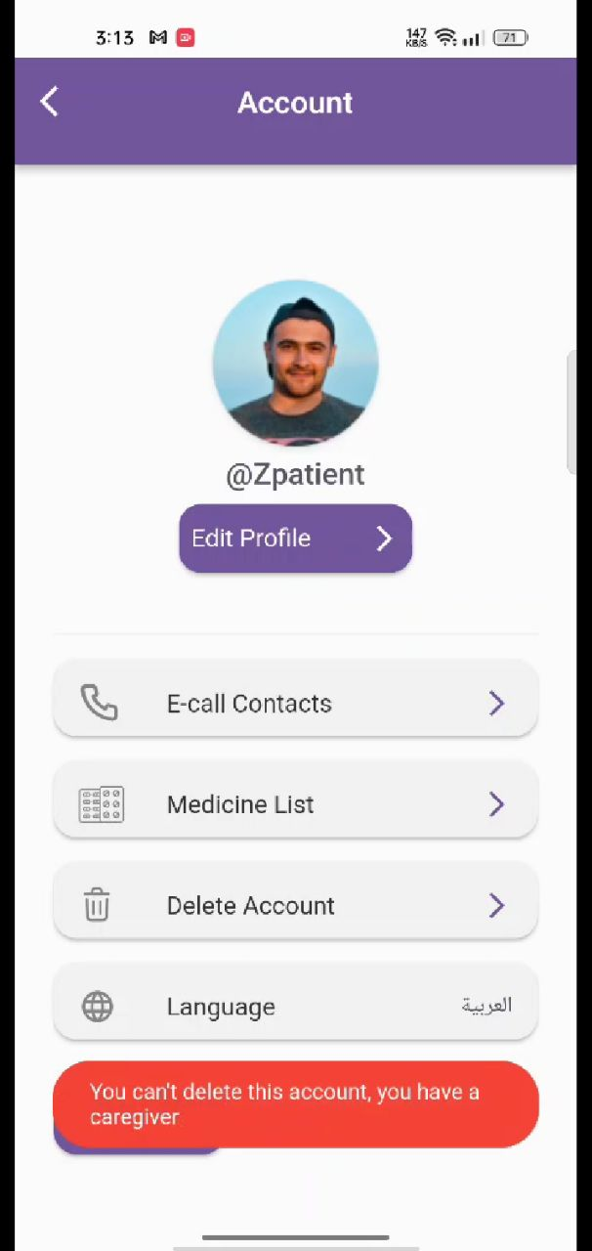
Accounts Profiles
Normal User Care Giver Patient

Slide 26
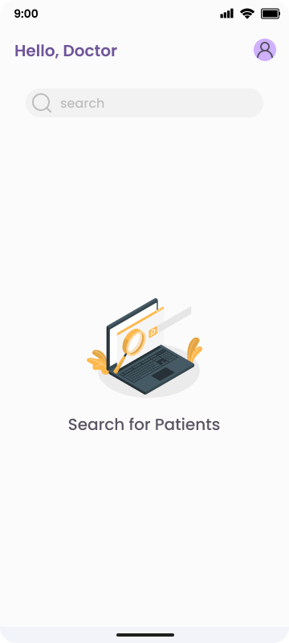
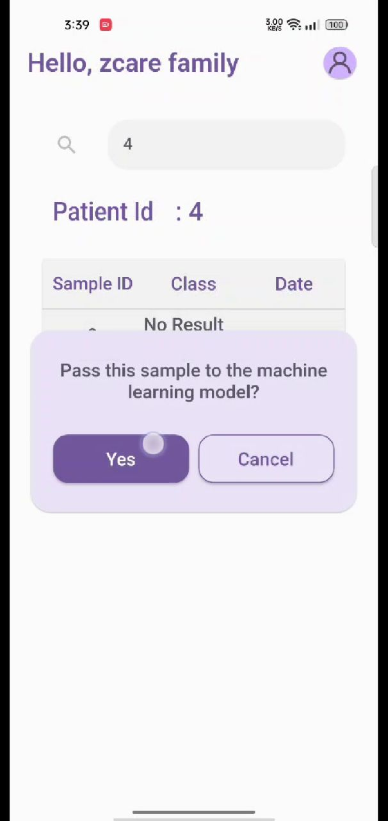

Doctor Features

Slide 27
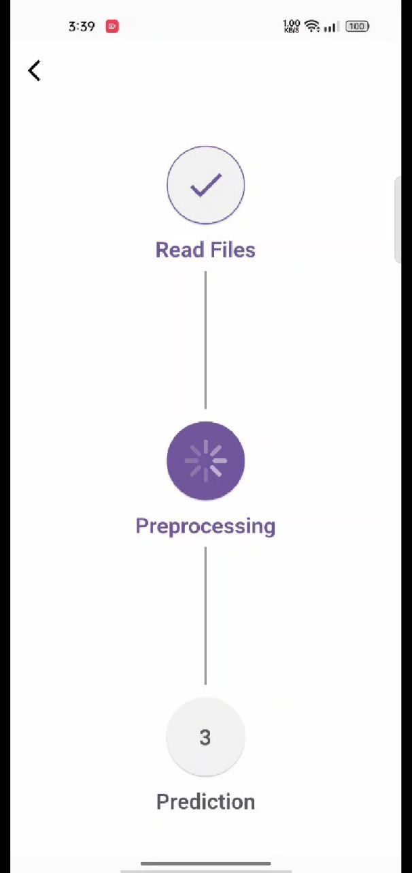
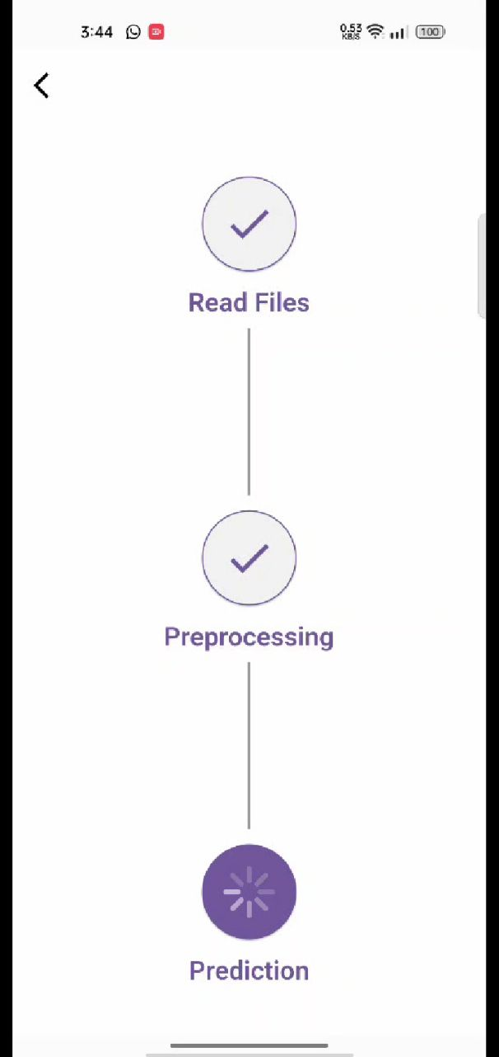
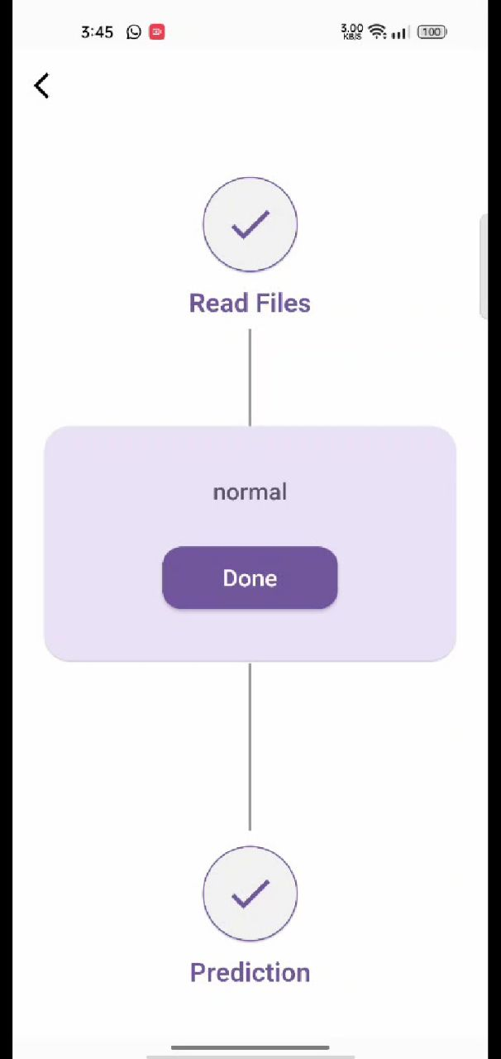

Slide 28
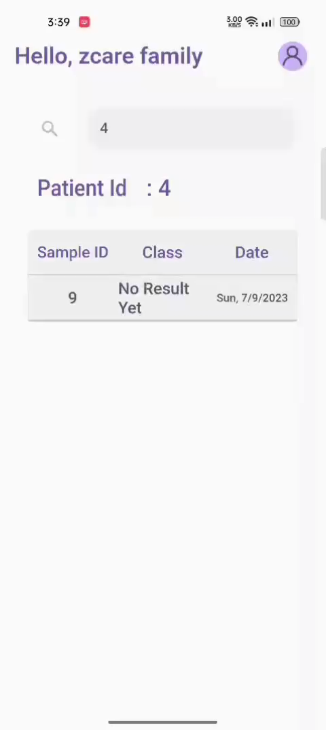

Slide 29
—Context Diagram

Slide 30
—Doctor DFD

Slide 31
-Patient DFD

Slide 32
—CareGiver DFD

Slide 33
—Patient, NormalUser, CareGiver Use case

Slide 34
-Doctor UseCase

Slide 35
Normal User Activity Diagram

Slide 36
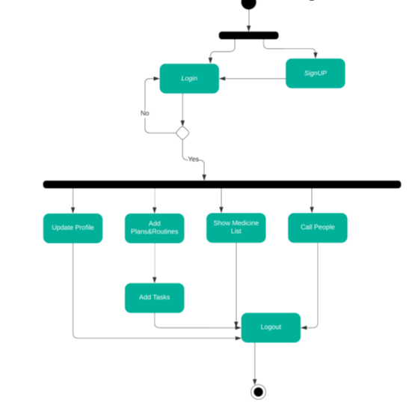
-Patient Activity diagram

Slide 37
- Doctor Activity diagram

Slide 38
- CareGiver Activity diagram

Slide 39
- Sequence diagram

Slide 40
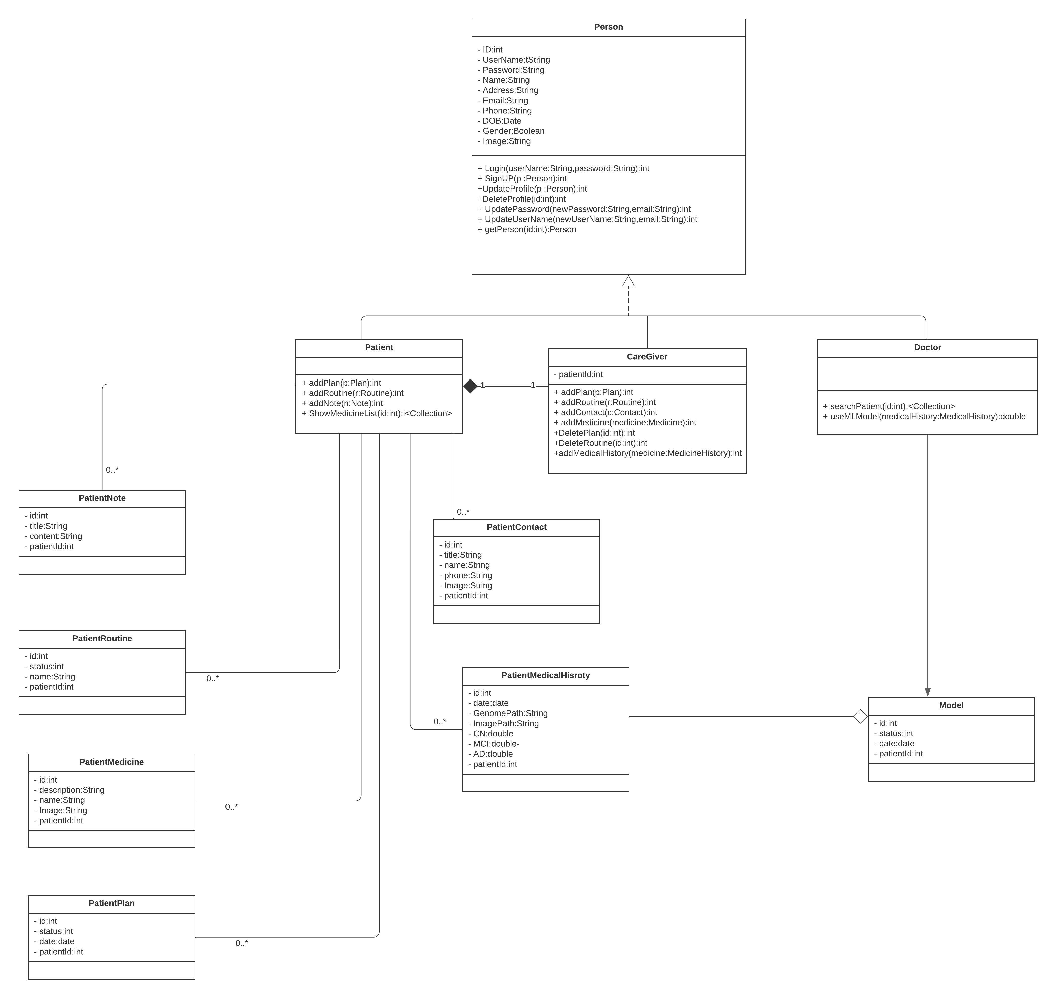
Class diagram

Slide 41
-ERD Diagram

Slide 42
Discussion & Experimental Results
06.

Slide 43
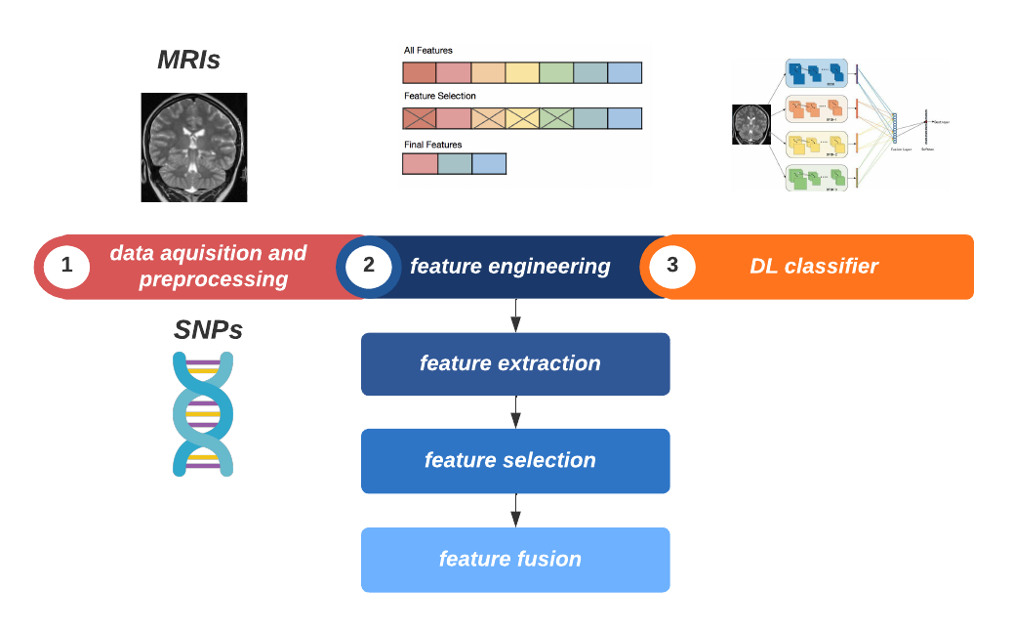
Framework

Slide 44

.
Data acquisition and preprocessing

Slide 45
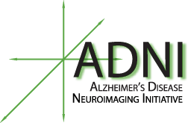

Data acquisition
Notes:
adni is a multicenter study designed to develop clinical, imaging, genetic all for the same person for the early detection and tracking of Alzheimer's disease (AD).
Ncbi to get reference to expression o allels

Slide 46
Data preprocessing
Notes:
But before data preprocessing In order to preprocess any data we have to understand it so we now are going to understand genetic data

Slide 47
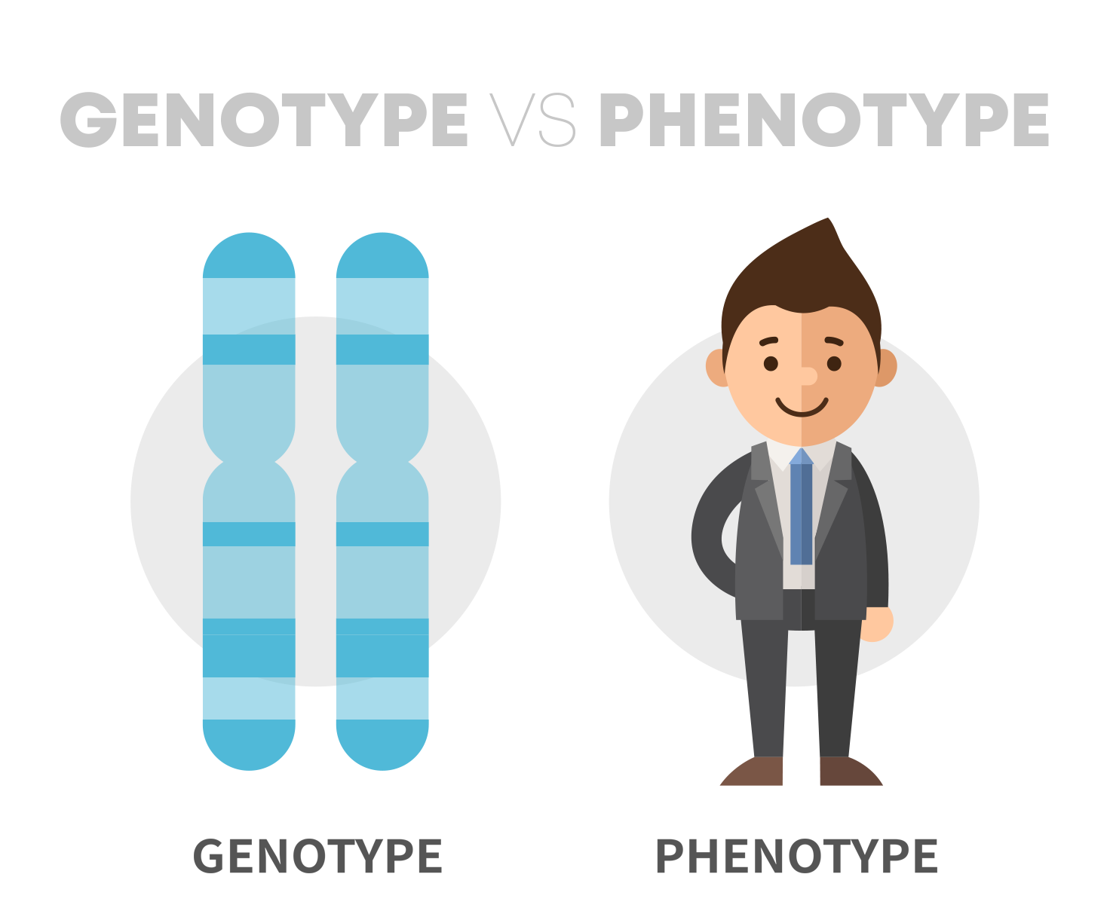
Notes:
The unique combination of these alleles across a genome is known as an individual’s genotype.
These gene variants still code for the same trait (i.e. eye color), but they differ in how the trait is expressed (an organism’s phenotype).
Genotype is collection of allels you have
Phenotype is characteristic you get from genotype

Slide 48
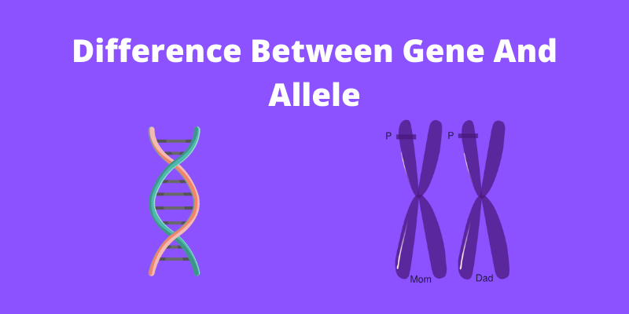
Notes:
alleles are matching genes; one from our biological mother, one from our biological father. We have two copies of every gene
Genes are chunks of DNA that contribute to particular traits or functions by coding for proteins that influence physiology. Alleles are different versions of a gene, which vary according to the nucleotide base present at a particular genome location

Slide 49
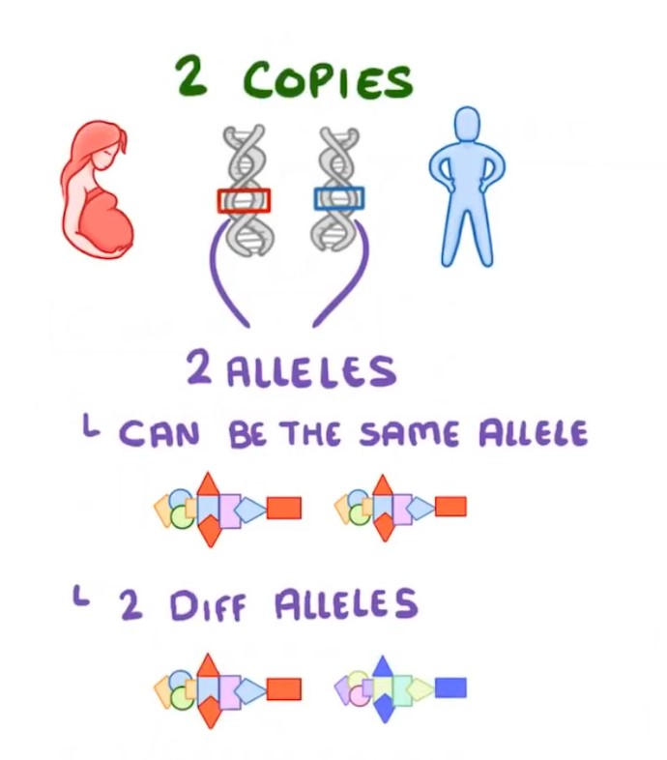

Slide 50
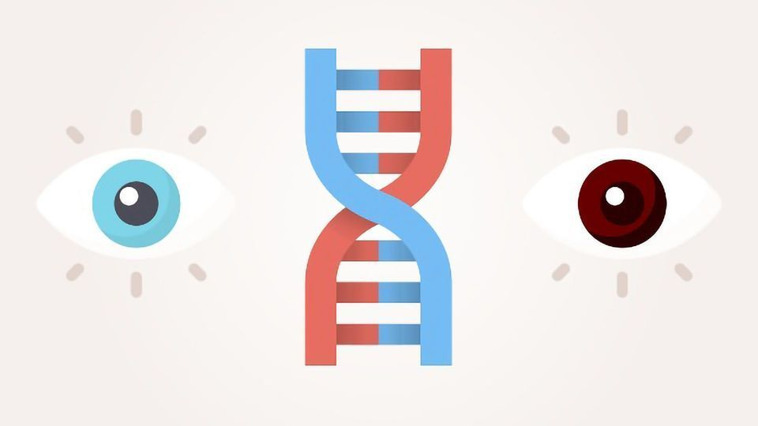
Notes:
Alleles different versions of the same gene

Slide 51
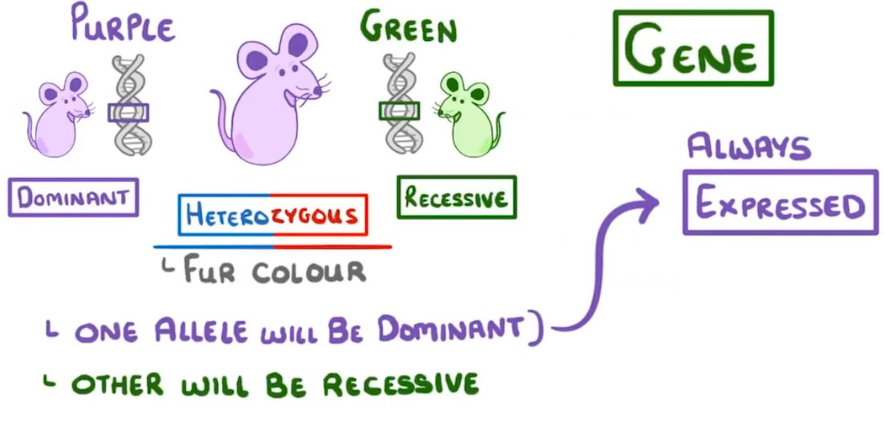

Slide 52

Notes:
You have thousand of genes that control reaction in your body
Gene like light switches appear when expressed
Gene turned on or off as needed
Sometimes genes get stuck causing mutation causing dysfunction
We need to discover this mutation

Slide 53
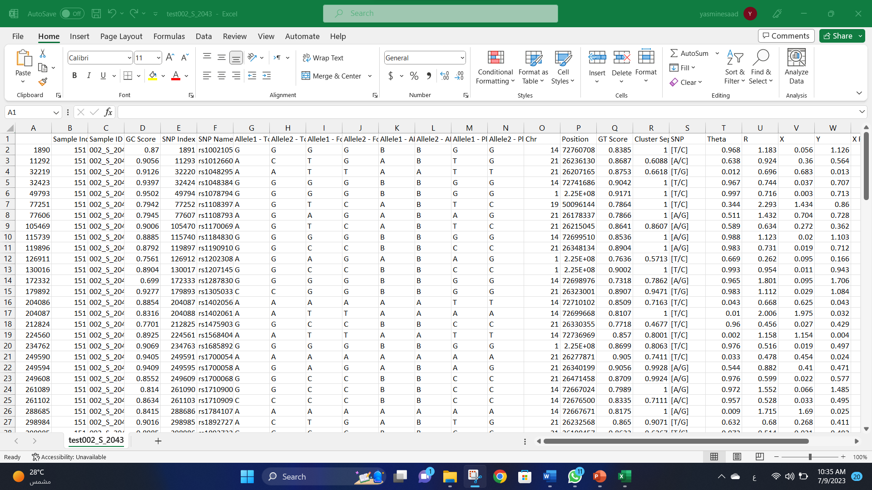

Slide 54
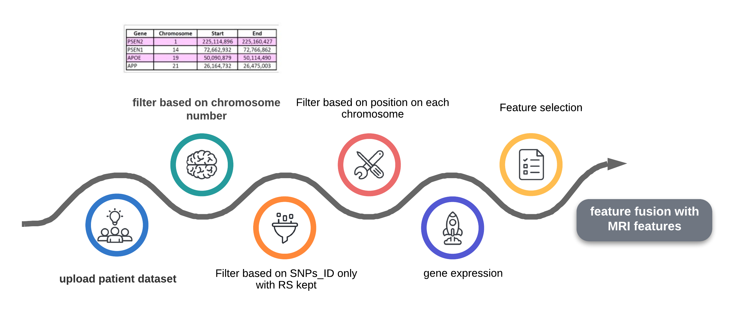
SNPs

Slide 55
Chromosomes responsible for AD

Slide 56
4 AD genes in the 4 mentioned chromosomes

Slide 57
Certain genes can increase the risk of developing dementia, including Alzheimer’s disease
The APP gene provides instructions for making a protein called amyloid
The PSEN1 gene provides instructions for making a protein called presenilin 1
The PSEN2 gene provides instructions for making a protein called presenilin 2. Presenilin 2
PSEN2,1 helps process proteins that transmit chemical signals from the cell membrane into the nucleus. Once in the nucleus, these signals turn on (activate) genes that are important for cell growth and maturation
4. APOE ε4 increases risk for Alzheimer's and is associated with an earlier age of disease onset in certain populations. About 15% to 25% of people have this allele, and 2% to 5% carry two copies APOE4 is the strongest risk factor gene for Alzheimer's disease apolipoprotein E gene called APOE4

Slide 58
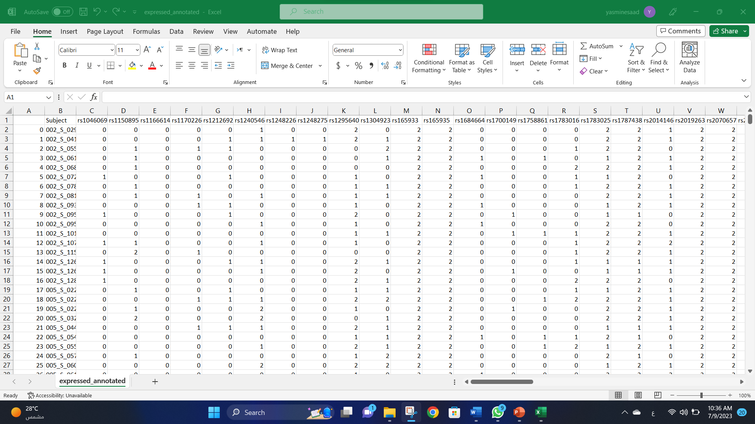

Slide 59
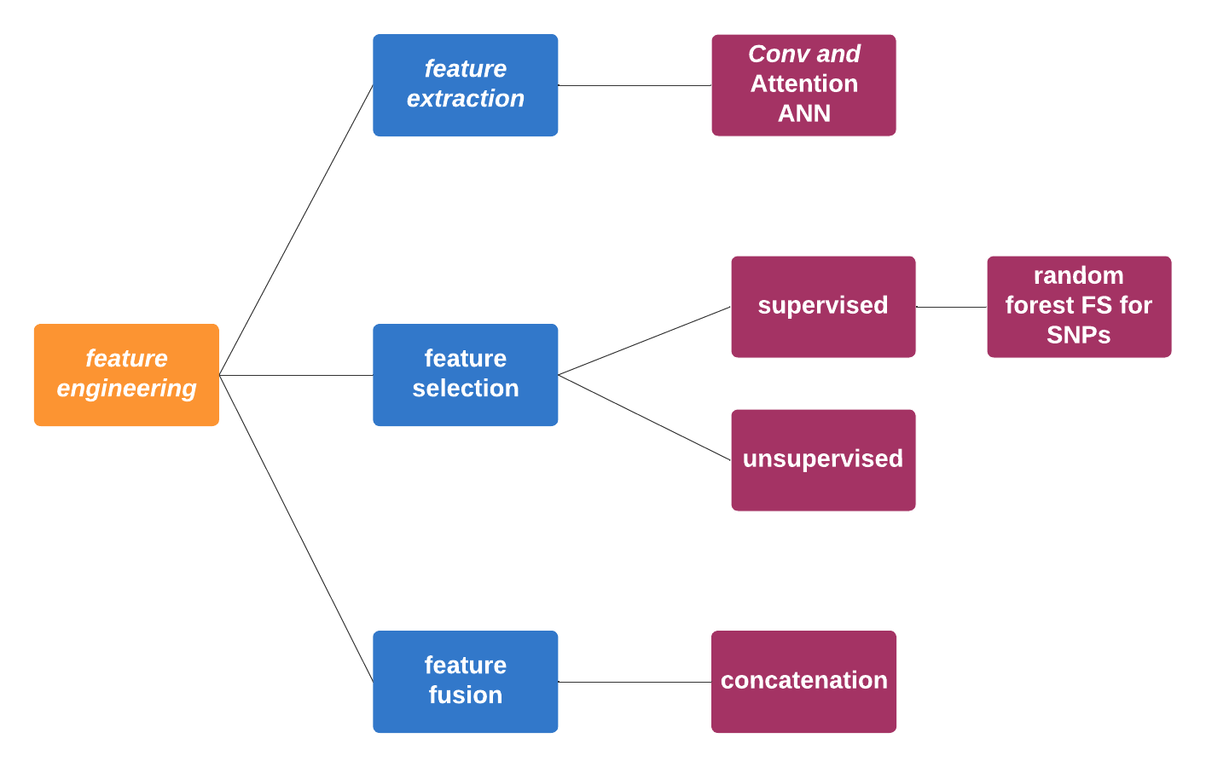
Feature engineering

Slide 60
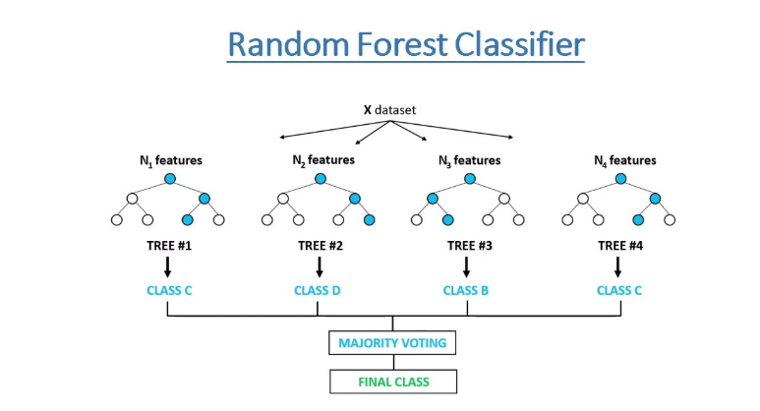
Feature selection using random forest for SNPs

Slide 61
[’rs1150895’, ’rs12126925’, ’rs12405469’, ’rs1295640’, ’rs16846644’, ’rs1783016’, ’rs1783025’, ’rs2014146’, ’rs2073489’, ’rs2156079’, ’rs216762’, ’rs2234983’, ’rs2256331’, ’rs2313007’, ’rs2802268’, ’rs2829973’, ’rs2829997’, ’rs2830000’, ’rs2830008’, ’rs2830012’, ’rs2830028’, ’rs2830033’, ’rs2830036’, ’rs2830038’, ’rs2830044’, ’rs2830052’, ’rs2830088’, ’rs362350’, ’rs362393’, ’rs373521’, ’rs3787620’, ’rs380417’, ’rs439401’, ’rs440666’, ’rs452987’, ’rs466448’, ’rs466609’, ’rs7276036’, ’rs7278838’, ’rs8006497’, ’rs8106922’, ’Sex’, ’Age’]
Produce 41 feature

Slide 62
MRIs
preprocessing

Slide 63
CN
AD

Slide 64
MCI

Slide 66
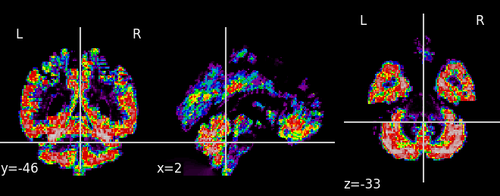
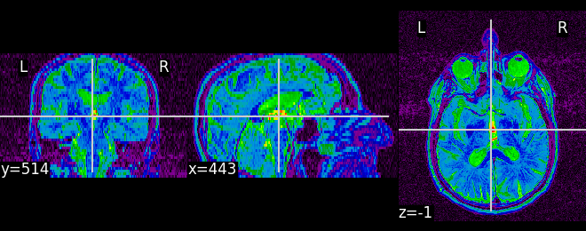
CN

Slide 67
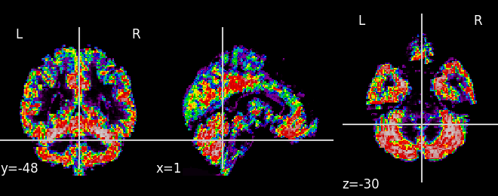
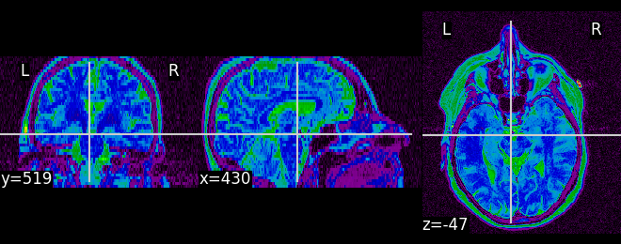
MCI

Slide 68
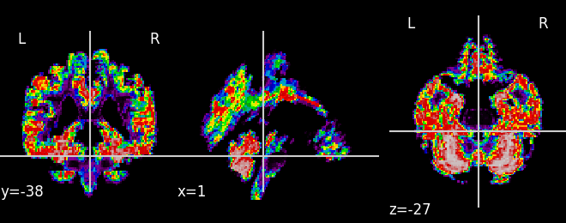
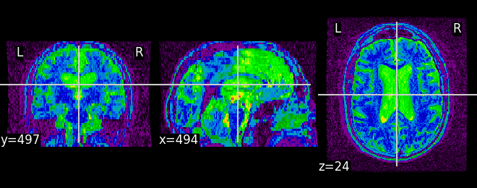
AD

Slide 69
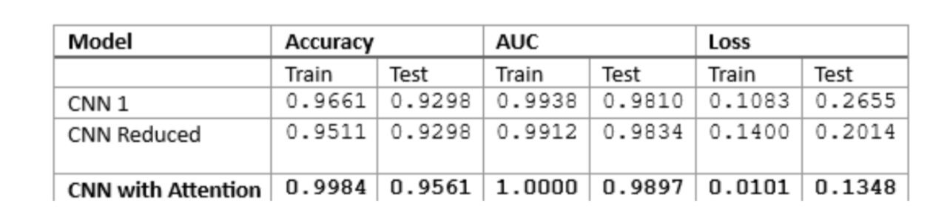

Slide 70
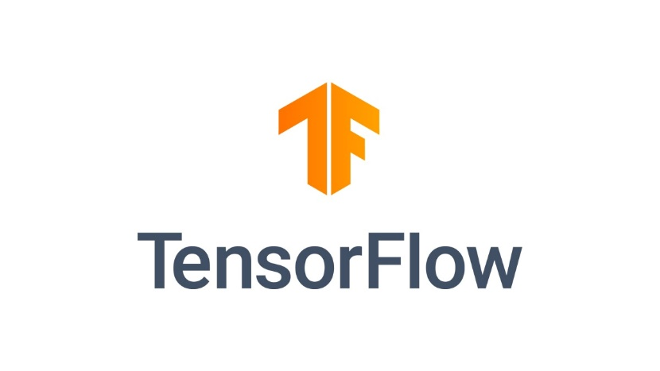


ZCARE Implementation, Used Technologies
and Techniques

Slide 71
07. Conclusions & Future Work

Slide 72
Conclusion
1.
2.
3.
Use multimodal data SNPs and MRIs ﻿﻿
binary classification CNN achieved an accuracy of 89.47% and 91.55% for NC vs. AD and MCI vs. AD, respectively. Finally, for multimodality, ZCARE achieved an accuracy of 79.17 %. Which is high compared to other studies
Gives more time for the family and loved ones to understand the disease and plan for their future.

Slide 73

Future work
Increase SNPs samples
2. Insert personalized medicine with our study.
3. In addition to MRIs and SNPs we intend to use clinical data to improve accuracy
4. Suggesting suitable medicine for each person depending on personalized medicine.
5. Follow the stages of disease development.
6. Add an expert user to manage data and model.
7. Apply Time Series Analysis to understanding the progression of AD for the Patient

Slide 74
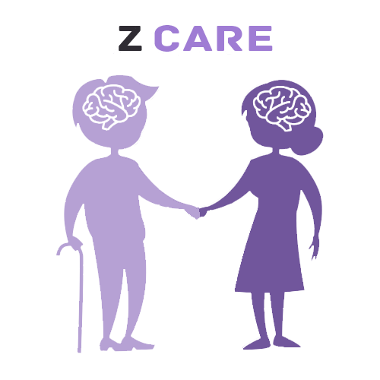
OUR Team
08.
Yasmeen Saad
Mohamed Ashraf
Shrouk Nasser
Sameul Adel
Mohamed Yasser

Slide 75
THANKS!

